Slide 1

Summarizing Software Artifacts: A Case Study of Bug Reports
Authors: Sarah Rastkar, Gail C. Murphy and Gabriel Murray
Flash talk by:
Aditi Garg, Xiaoran Wang

Slide 2
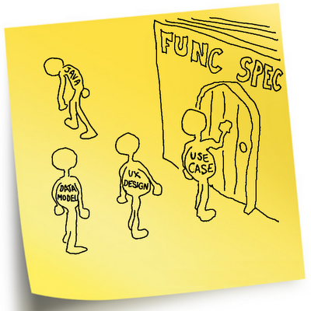
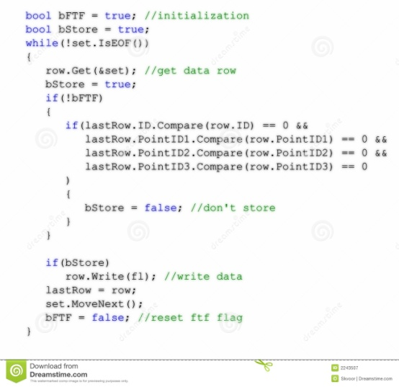
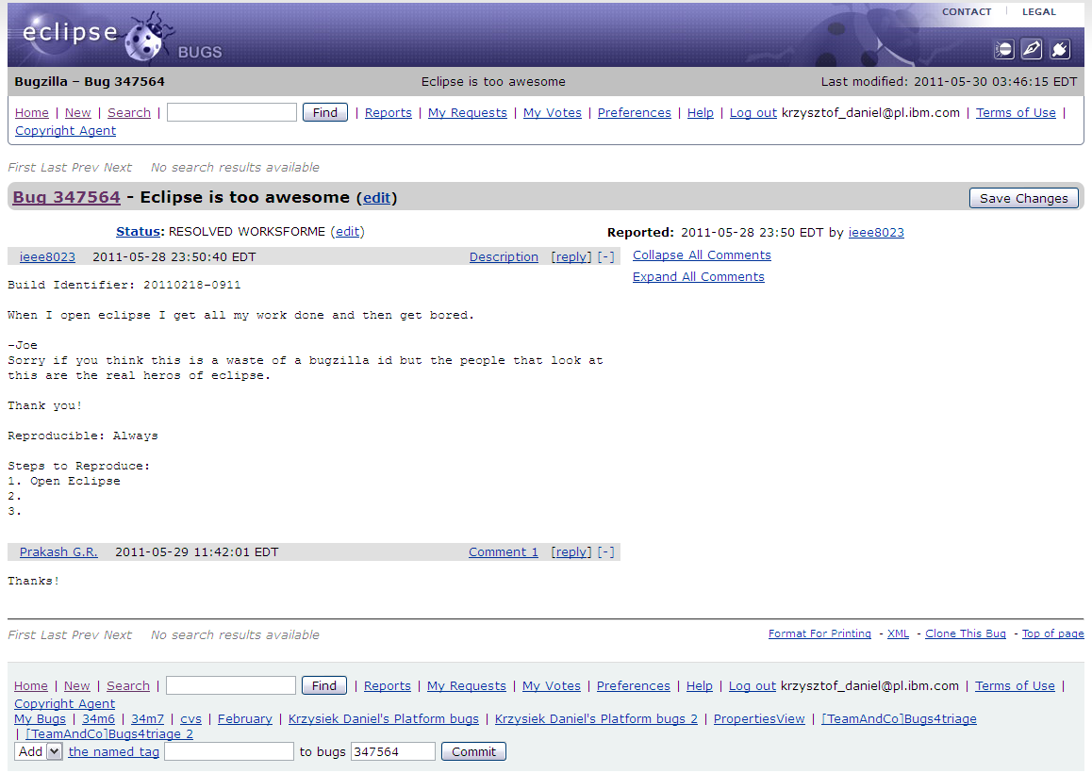


Software Artifacts
Source code
Requirements document
Bug reports
Design
documents
Email archives
Software engineering : More than just software development!
Strong component of Information Management.
Notes:
As you all must be aware that many software artifacts are created, maintained and evolved as a part of a software development project. To begin with, we have the requirements and the design documents followed by the source code, email threads, bug reports, etc.
Hence, we all understand that software development is more than just programming ! Any large and successful software system requires creation and management of all these artifacts : Information management

Slide 3



THE PROBLEM
TO PERFORM WORK on the system: READ and understand artifacts associated with the software
Specifically, to fix a performance the bug,
KNOWN THAT A SIMILAR BUG WAS SOLVED SOME TIME AGO
PERFORM SEARCHES AND READ SEVERAL BUG REPORTS
FIX A PERFORMANCE BUG
Notes:
In order to perform any task, a developer needs to peruse a substantial amount of text. Specifically, to FIX A PERFORMANCE BUG, known that a similar bug was solved six months ago, will REQUIRE the developer TO PERFORM SEARCHES AND READ SEVERAL BUG REPORTS in search of the report of interest before actually performing the task of fixing the bug. Each of these report may in turn contain tens of sentences.

Slide 4
Problem
In addition,
READ LIBRARY DOCUMENTATIONS associated with the bug to get a better understanding of the class/situation
ABANDON SEARCH
DUPLICATION
NON-OPTIMIZED WORK
Notes:
In addition, the developer may also have to read through the library documentations for the classes associated with the bug to get a better understanding of the class/situation
All this information may prove to be overwhelming, and may lead to abandoning of search and performing duplication, non-optimized work

Slide 5

What could be helpful in such a scenario?
Provide summary for each artifact
Optimally, the authors of artifacts
may write an to help developers
NOT LIKELY TO OCCUR!
Alternative?
Generate summaries through AUTOMATION
Our focus: BUG REPORTS
Notes:
How can we help the developers in such a scenario? The optimal situation could be wherein the author of the artifacts provide an abstractive summary which will enable the developer to spend less time reading and searching than to actually dealing with the development task. However, this is not likely to occur. We need to devise a technique that could automatically perform the task of summarizing the artifacts instead of relying on the authors. Hence, the authors here focus on the possibility of automatic summary generation for one of the artifacts, i.e. bug reports.
Why only bug reports?
- Number of cases where they might be used, eg, triaging bugs, change tasks. To make the investigation tractable

Slide 6
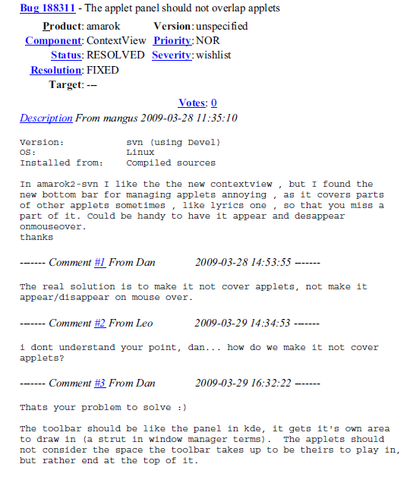
Software artifact: Bug reports
Free-form text
Sentences
Resembles a conversation
Sentences
Sentences
Sentences
Notes:
Before going ahead, it would be appropriate here to explain the structure of a bug report. As you can see a bug report resembles a conversation and may contain several sentences of description as well as tens of sentences representing discussion among team members
-Usually involves free-form text including title, summary, description and a series of time-stamps comments that capture conversation b/w developers related to the bug

Slide 7
Motivation for bug reports
Related work
Contain substantial knowledge about a software development
As many repositories experience a high rate of change in the information stored [Anvik et al. 2005]
Techniques to provide recommenders for assigning a report[Anvik et al. 2006]
Detect duplicate reports [Runeson et al. 2007, Wang et al. 2008]
Other works: To improve bug reports, Asses bug report quality[Bettenburg et al. 2008]
NONE TO EXTRACT MEANINGFUL SUMMARIES FOR DEVELOPERS !!!
Notes:
Hence, for this study, the authors use bug reports for generating summaries as they contain a substantial knowledge about the software development. Looking at the previous work on bug reports it has been observed that many repositories experience a high rate of change in the information stored, most of the techniques for bug reports have to detect duplicates or recommend whom to assign the report. However, there has been no work to extract meaningful summaries from bug reports for developers.

Slide 8


Related work
Generating summaries [Klimt et al. 2004]
Extractive
Selects a subset of existing sentences to form the summary
Abstractive
builds an internal semantic representation of the text, applies NLP techniques to create a summary
Notes:
It is also important here to understand the two different approaches that are taken to summarizing a document. One is extractive that selects a subset of the existing sentences to form the summary. The other is abstractive which builds an internal semantic representation of the text and applies NLP techniques to create a summary. We FOCUS HERE ON EXTRACTIVE TECHNIQUES for bug reports.

Slide 9



State of the art: Extractive techniques for..
Related work
Meeting discussion [Zechner et al. 2002], telephone conversations [Zhu et al. 2006] and emails[Rambow et al. 2004]
Murray et al. 2008: Developed a summarizer for emails and meetings, found that general conversation systems competitive with state-of-the-art domain specific systems.
Notes:
extractive techniques have been developed in the past for artifacts such as meeting discussions, telephone conversation and email threads. A significant work was done by Murray and others to develop summaries from emails and meeting. They found that the general conversation systems competitive were competitive with the state-of the art domain specific systems.

Slide 10

Overview of the technique and contribution
Human annotators created summaries of 36 bug reports -> corpus
Applied existing classifiers on bug reports corpus
Trained a classifier on bug reports and applied to corpus
All classifiers perform well, bug report classifier outperforms
Measured effectiveness of the classifiers
Results evaluated by human judges for a subset of summaries
Arithmetic mean quality ranking of summaries generated: 3.69(5.00)
Notes:
At this point, I would like to give an overview of the technique and contribution of this paper. Problem similar to summarizing emails and meeting discussions. The authors had human annotators to create summaries of 36 bug reports, creating a corpus of bug report data.
They investigate whether the existing ML based approaches (classifiers) for extracting summaries will work for bug reports. Applied existing classifiers trained on emails and meeting discussions to produce summaries for reports for reports in the corpus
Also trained classifier trained on bug reports and applied on corpus
Assign zero or one to each sentence, sentences assigned one appear in the generated summary. Measured effectiveness of these classifiers based on several computed measures.
Result: All classifier perform well, bug report classifier (62% precision) out- performs other two.
Evaluate result: Human judges evaluated goodness of a subset of summaries produced by the bug report classifier.
Arithmetic mean quality ranking of summaries generated: 3.69(5.00)

Slide 11





Methodology: Forming the Bug report corpus
Step 1: Recruit ten grad students
Annotate collection of bug reports.
Step 2: Annotation Process
- Each individual ANNOTATE A SUBSET OF BUGS from the four diverse open-source software projects
- NINE BUG REPORTS from each project(36) were chosen for annotation, mostly conversations
Notes:
The authors chose nine bug reports each from four different open-source software projects: Eclipse Platform, Gnome, Mozilla, and KDE. Most of them had a major portion as text and they avoided choosing the once with code or stack traces. The graph here shows some statistics for the reports chosen. Around 69% of the report had 5-14 lines of comments while the remaining 31% had 15-25 comments each. Also, nine of the 36 bug reports, i.e. ¼th of the bug reports were enhancements and remaining 3/4th or 75% were defects

Slide 12
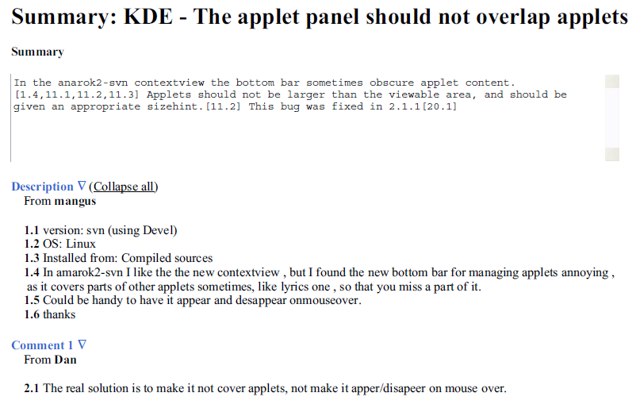
Approach
Step 2: continued..
Each annotator: WROTE AN ABSTRACTIVE SUMMARY, own sentences , maximum 250 words.
Also asked -> how each sentence in the abstractive summary maps to one or more sentences from original bug report.
Abstractive summary
Figure 3
Notes:
The annotators were asked to write an abstractive summary for each bug repost assigned to them in not more than 250 words. Next, they were asked to specify how each sentence in the abstractive summary maps (links) to one or more sentences from the original bug report by listing the numbers of mapped sentences from the original report.
Show example, figure 3
- the summary at the top is an abstractive summary written by an annotator with the mapping to the sentences from the original bug report marked.

Slide 13

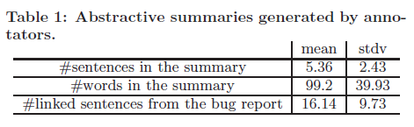
Annotated bug reports
Approach
Summarized by annotators to
Bug reports with an average of 65 sentences
Abstractive summary of 5 sentences
Notes:
On an average, the bug reports comprised of 65 sentences and on average, the summaries created by the annotators comprised just over five sentences. The table here shows some more statistics for the number of sentences in the summary, the number of words in the summary and the linked sentences from the bug reports.

Slide 14




Kappa test for bug report annotations
Approach
Summarization - subjective
Annotators - do not agree on a single best summary
Each bug report assigned to three annotators
TO MEASURE THE LEVEL OF AGREEMENT between annotators
K value = 0.41 for kappa test, showing a moderate level of agreement
Notes:
A common problem is that annotators often do not agree on a single best summary due to the fact that summarization is a subjective process. Hence, there can be no single best summary. As a solution to this problem, the authors use the kappa test. They assigned each bug report to three annotators instead of one and then the level of agreement is measured between the annotators, which is depicted by the k value. For this study, the k value comes out to be 0.41 which shows a moderate level of agreement.

Slide 15
At the end of annotating..
Approach
Following points determined about property of the report from each annotator:
Level of difficulty (2.68)
The amount of irrelevant and off-topic discussion in the bug report (2.11)
The level of project-specific terminology used in the bug report (2.68)
Notes:
At the end of the annotating process, the following three points were determined about the property of the report through the inputs of each annotator. The first was to determine level of difficulty of summarizing the bug report. The second was the amount of irrelevant and off-topic discussion in the bug report. The third was the level of project-specific terminology used in the report.

Slide 16
Post annotation: Summarizing the bug reports
Approach
The authors investigated two questions:
Can we produce good summaries with existing conversation-based classifiers?
EC (email threads, Enron email corpus)
EMC(combination of email threads and meetings, a subset of AMI meeting corpus)
2. How much better can we do with a classifier specifically trained on bug reports
BRC(bug report corpus we created)
Notes:
Once the annotation process was complete, the next step was to generate summaries. The authors approached this by investigating two questions. One which dealt with the existing conversation based- classifier. The second that dealt with a classifier specifically trained on bug reports. The two existing classifiers are referred as EC which is trained on email thread and EMC which is trained on a combination of email threads and meetings. The classifier trained on bug reports is referred as BRC.

Slide 17
Training set for BRC
Approach
Combined three human annotations for each bug report
Sentence score: number of times linked by annotators (0-3)
Part of extractive summary, score >2
For each bug report, set of sentences, score > 2: gold standard summary
Notes:
Combined three human annotations for each bug report by scoring each sentence of the report based on the number of times it has been linked by annotators. So if a sentence is not linked by any annotators, it gets a score of zero and if it is linked by all all three annotators, it gets a score 3. So all the sentences with a score of two or more are considered to be the part of extractive summary and the set of all such sentences comprises what is called as the gold standard summary.

Slide 18
For the bug report corpus, gold standard summary includes..
Approach
Use cross validation technique when evaluating classifier – leave one out procedure
Notes:
From the graph, you can see the Gold standard summary comprises of 465 sentences which is:
19.7% of all the sentences in the corpus
28.3% of all the words in the corpus
The authors use a cross validation technique, where they leave one part of the corpus and train the classifier on the remainder of the bug report corpus

Slide 19

Why general classifiers at first place?
Approach
General, appealing to use
If they work well for bug reports, offers hope they might be applicable to software project artifacts without training on each specific kind of software artifacts
lowers the cost of producing summaries
Notes:
One of the question that might arise is that why do we even consider general classifiers at first place when we can train a classifier on the bug reports. As previously mentioned too, the purpose is to determine if general purpose classifiers can be used to generate summaries for software artifacts? The EC and EMC classifiers are appealing to use because of their generality. If these classifiers work well for bug reports, it offers hope that general classifiers might be applicable to software project artifacts without training on each specific kind of software artifacts (which can vary between projects) or on project-specific artifacts, lowering the cost of producing summaries.

Slide 20
More about classifiers..
Logistic regression classifiers.
Generate the probability of each sentence
To form the summary, sort the sentences based on probability values in descending order.
Select sentences until 25% of the bug report word count.
The selected sentences form generated extractive summary.
Why 25%? because this value is close to the word count percentage of gold standard summaries (28.3%).
Notes:
Here, I would like to mention a few more points about the classifiers. All three classifiers investigated are logistic regression classifiers.
Instead of generating an output of zero or one, these classifiers generate the probability of each sentence being part of an extractive summary. To form the summary, we sort the sentences into a list based on their probability values in descending order. Starting from the beginning of this list, we select sentences until we reach 25% of the bug report word count. The selected sentences form the generated extractive summary. We chose to target summaries of 25% of the bug report word count because this value is close to the word count percentage of gold standard summaries (28.3%).

Slide 21
Classifiers: Conversation features
The classifiers can learn based on 24 different features categorized into four major groups
Structural: conversation structure of the bug reports
Participant: conversation participants, eg, sentence made by same person who filed the bug report
Length: length of the sentence normalized by the length of the longest sentence in the comment and bug report
Lexical: occurrence of unique words in the sentence
Notes:
All the three classifiers can learn based on 24 different features of the bug reports categorized into four broad categories, structural, participant, length, and lexical. Example of structural feature could be the position of the sentence in the comment or the report. An example of participant feature is whether the sentence is made by same person who filed the report. The length feature includes the length of the sentence normalized by length of the longest sentence in the comment or report. And the lexical features are related to the occurrence of unique words in the sentence.

Slide 22
Approach revisited
Annotation process – gold standard summaries
Kappa test – to resolve disagreement
Train classifiers: EC, EMC and BRC
Extract summary based on the probability values
Notes:
The remaining sections will be presented by Xiaoran.

Slide 23
Evaluation
Comparing Base Effectiveness
Comparing Classifiers
Feature Selection Analysis
Human Evaluation
Threats

Slide 24
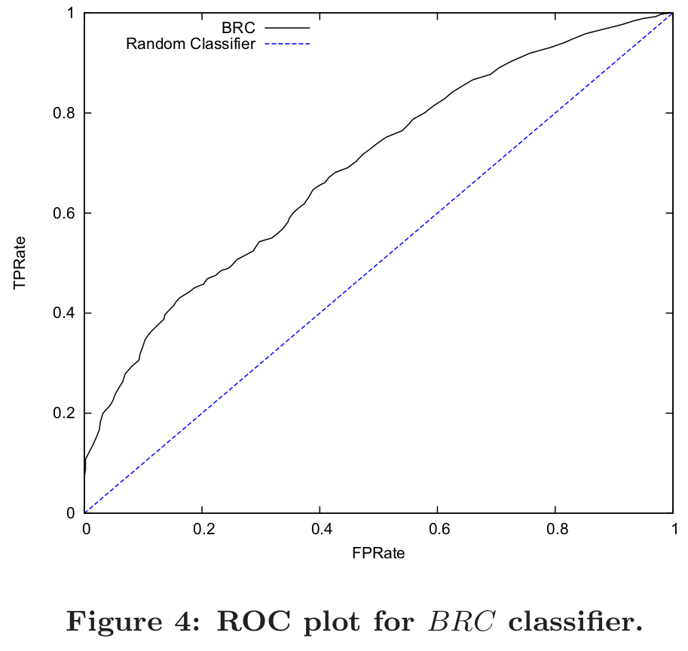
Comparing Base Effectiveness
A random classifier has an AUROC value of 0.5.
BRC’s AUROC value is 0.72.
BRC performs better than a random classifier.

Slide 25
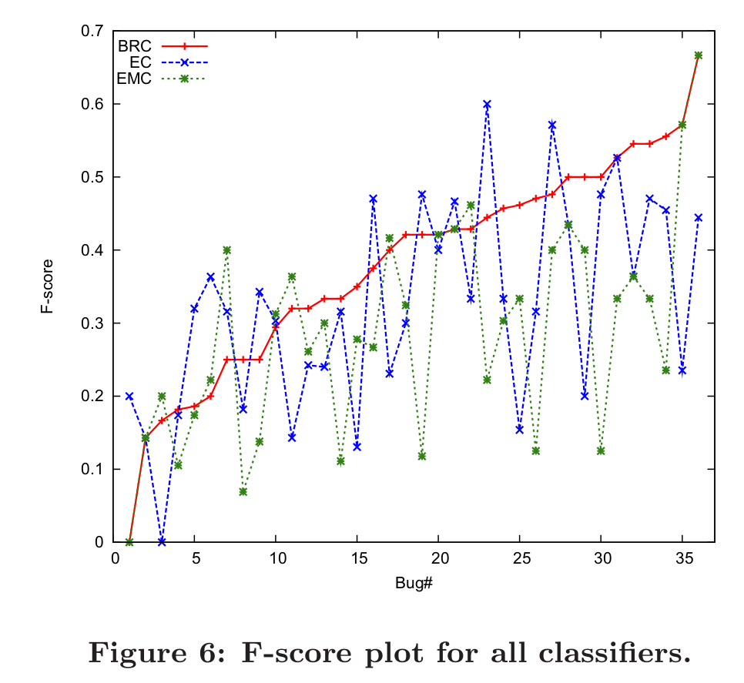
Comparing Classifiers (1) F-score
F-score is an overall measure of precision and recall.
Bug reports are sorted based on the F-score for the summaries generated by BRC.
Best F-score typically occurs with the BRC classifier!

Slide 26
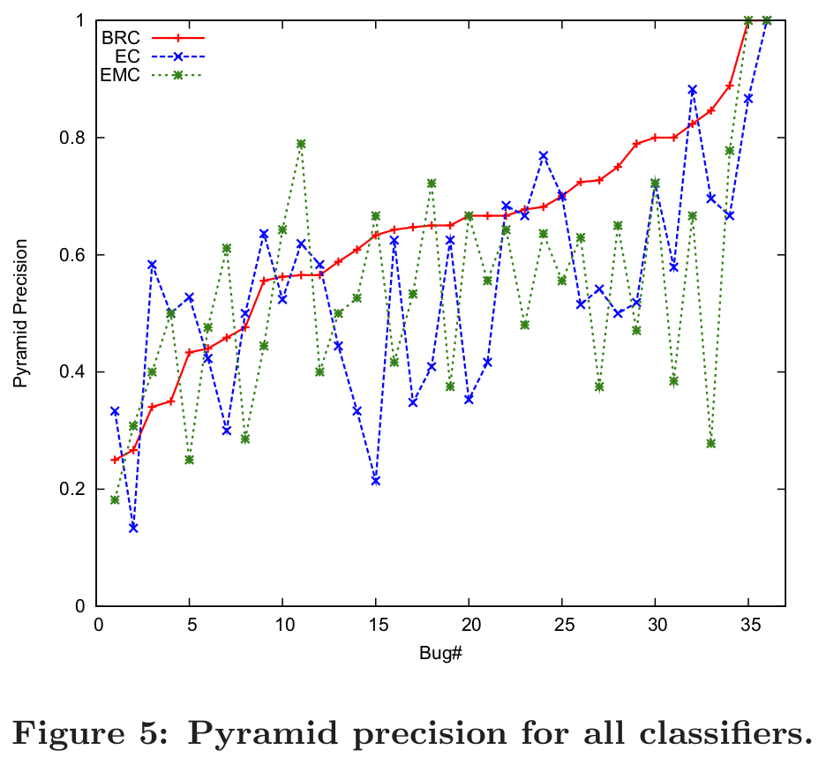
Comparing Classifiers (1) Pyramid Precision
The basic idea of pyramid precision: count the total number of times the sentences selected in the summary are linked by annotators.
BRC has better precision values for most of the bug reports.

Slide 27
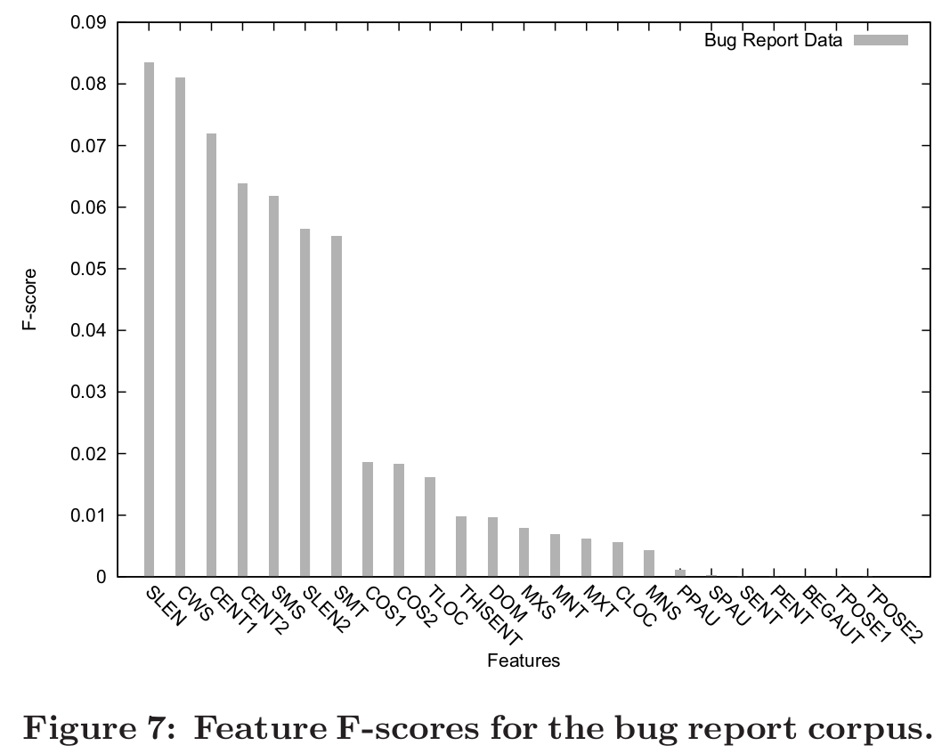
Feature Selection Analysis
The length features(SLEN & SLEN1) are most helpful.
Several lexical features (CWS, CENT1, CENT2, SMS, SMT) are also helpful.
The results indicates that they may be able to train more efficient classifiers by combining lexical and length features.

Slide 28
Human Evaluation (1)
8 human judges
8 summaries generated by BRC classifier
Each was evaluated by 3 different judges
Use a 5-point scale with 5 the high value
Rank each bug report summary based on four statements.

Slide 29
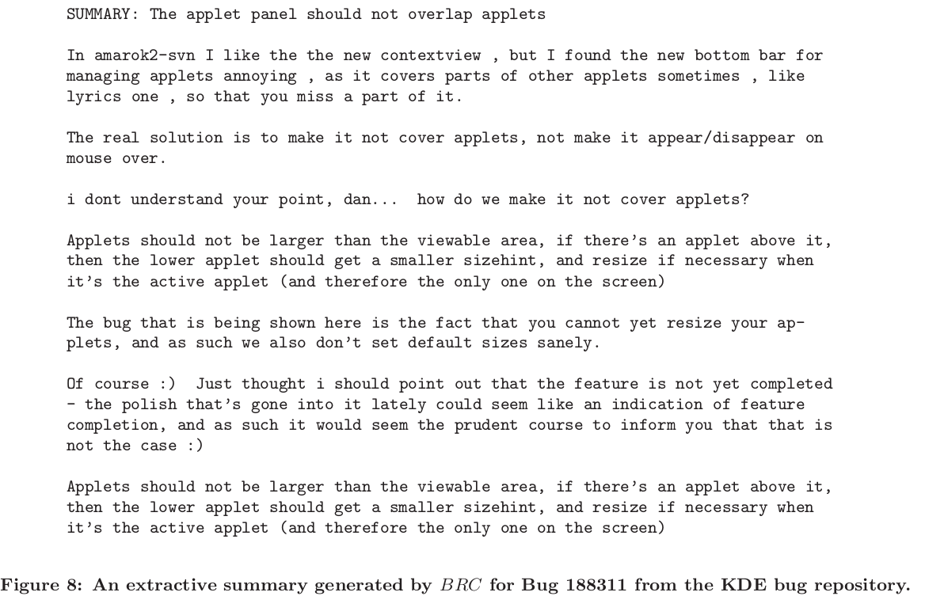
Human Evaluation (2)

Slide 30
Human Evaluation (3)
1.The important points of the bug report are represented in the summary. (3.54 ± 1.10)
2. The summary avoids redundancy. (4.00 ± 1.25)
3. The summary does not contain unnecessary information. (3.91 ± 1.10)
4. The summary is coherent. (3.29 ± 1.16)

Slide 31
Threats
1. Size of bug report corpus
2.The annotation by non-experts in the projects

Slide 32
Discussion
Using a Bug Report Summary
Summarizing Other Project Artifacts
Improving a Bug Report Summarizer
Generalizing the summarizer
Augmenting the set of features
Using the intent of sentences
Using abstractive summarizer

Slide 33
Summary
Conversion-based extractive summary generators can produce summaries better than a random classifier.
An extractive summary generator trained on bug reports produces best results.
The generated summaries contain important points from original reports and are coherent.
The work open up possibilities for recommending duplicate bug reports and summarizing other software project artifacts.

Slide 34


